Slide 1
Acute abdomen in children
MICHAEL D(MD,R3)
NOVEMBER ,2024

Slide 2
OUTLINES
Acute abdomen
Intussusception
Acute appendicitis
Peritonitis
References

Slide 3
Acute Abdomen
Non-traumatic abdominal emergency characterized by sudden onset of abdominal pain.
It signifies the need for prompt diagnosis/treatment, never be equated with need for mandatory operation.
Even though most are self-limiting conditions, it presents a diagnostic dilemma.
A child presenting with abdominal pain may be suffering from any of a wide range of conditions.

Slide 4
Introduction
Most will be benign, however the small percentage of children with a life-threatening condition need to be treated with greater urgency than adult patients with equivalent conditions because they often have fewer physiological reserves.
In the pre-verbal child, the presence of abdominal pain can only be inferred from the child’s behavior and/or from distension and/or tenderness on examination.

Slide 5
Acute abdominal pain: Three categories
Visceral ( Splanchnic)
Tension, stretch, ischemia, distension
Dull poorly localized, mid line
Parietal (Somatic)
Parietal peritoneal involvement
Sharp, intense, discrete, well localized
Referred
Same as parietal, but felt remote

Slide 6
Clinical evaluation: Pain
Sudden/Gradual onset
Time course of pain
Site and character
Aggravating/Relieving factor
Radiation/Shift
Pain severity
Progression and migration
Analgesic use
Prior history of similar pain

Slide 7
HistoAry: Associated Symptoms
Nausea/vomiting
Before or after pain?
Diarrhea/Bloody
Before or after pain?
Constipation
Jaundice
Anorexia
History of trauma
Urinary symptoms
Cough and chest symptoms
Alcohol intake
Associated symptoms
Gynecologic history
Past illness
Family history
Drug use

Slide 8
Physical Exam: General
General Appearance
Lies perfectly still:➔ Inflammation, peritonitis
Restless, writhing:➔ Colic, obstruction
Vital signs
Tachycardic➔? Early shock (Important than BP)
Rapid shallow breathing:➔ peritonitis
Level of hydration
Fever

Slide 9
Physical Exam: General
Bowel Sounds
Listen 1 minute in each quadrant before palpation
Absent bowel sounds:➔ ileus, peritonitis, shock
Palpate each quadrant
Work toward area of pain with warm hands
Patient on back and knee bent (if possible)
Tenderness/Rebound tenderness, rigidity, involuntary guarding, voluntary guarding, masses
Point of maximal tenderness ?

Slide 10
Physical Exam: General
Percussion:
Indirect rebound tenderness
Gaseous or fluidly distention
Rectal exam
Bleeding, Mass, Tenderness
Pelvic exam and testicular exam
Chest exam ,Jaundice, pallor, Cullen's, Grey Turner’s, …

Slide 11
Abdominal Special Tests: Signs
Obturator
Psoas
Murphy’s
Rovsing’s

Slide 12
Child abuse
Accidental injury
Evidence of trauma
Pharyngitis/UTI
Gastroenteritis
Mesenteric adenitis
Pneumonia
Appendicitis
Fever
Left-sided pain
Constipation
Ovarian/Testicular torsion
Middle or right sided pain
Appendicitis
Ovarian/Testicular torsion
Mesenteric adenitis
Presence in other contacts
Food poisoning
Gastroenteritis

Slide 13
PID
Ectopic pregnancy
Sexually active
Intussusception
IBD
Gastro-enteritis
Purpura
Blood in stool
Hematuria
Renal calculi
Renal trauma
UTI
Evidence of obstruction
Malrotation
Intussusception
Volvulus

Slide 14
Abdominal Pain by Predominant Age
Two to five years
Gastroenteritis**
Appendicitis**
Constipation
Urinary tract infection
Intussusception
Volvulus
Trauma
Pharyngitis
Sickle cell crisis
Mesenteric lymphadenitis
Birth to one year
Infantile colic**
Gastroenteritis**
Intussusception**
Constipation
Urinary tract infection
Volvulus
Incarcerated hernia
Hirschsprung’s disease

Slide 15
Abdominal Pain by Predominant Age
Six to 11 years
Gastroenteritis**
Appendicitis**
Constipation
Functional pain
Urinary tract infection
Trauma
Pharyngitis
Sickle cell crisis
Mesenteric lymphadenitis
12 to 18 years
Appendicitis**
Dysmenorrhea**
Mittelschmerz**
Gastroenteritis
Constipation
PID
Threatened abortion
Ectopic pregnancy
Ovarian/testicular torsion

Slide 16
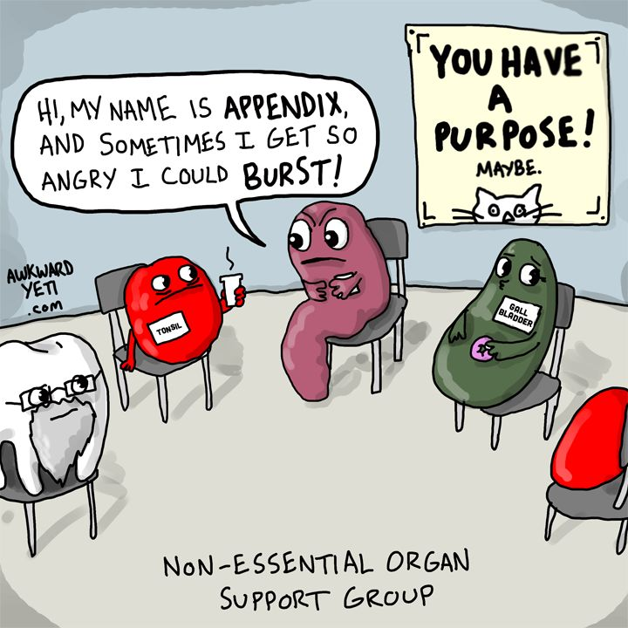
Acute Appendicitis

Slide 17
Introduction
Acute appendicitis is the commonest cause of abdominal pain leading to emergency abdominal surgery in pediatrics.
Life time risk: 7%, 1.1 cases per 1000 people per year and some familial predisposition exists.
The Pathophysiology of appendicitis is due to a closed loop obstruction of the appendix.
hyperplasia of the submucosal lymphoid follicles.
Fecaliths
Parasites
Foreign bodies

Slide 18
Incidence
Sex: Male: female ~ 1.4:1.
Age: Mean age in pediatrics is 6-10 years.
Incidence of appendicitis is rare in neonate and infants, rises and peaks in the late teen years, and gradually declines in the geriatric years.
In the younger child, the omentum is less developed and less likely to wall off a perforation, making peritonitis more likely.

Slide 19
Pathophysiology
Obstruction of the appendiceal lumen
Increasing intraluminal pressure + mucosal edema.
Venous and lymphatic obstruction
Ischemic inflammation of the appendix.
Bacterial proliferation
Perforation will
Arterial obstruction and gangrene
Peritonitis develops.
The overall mortality ~ 0.2-0.8% is attributable to complications of the disease..

Slide 20
Clinical presentation
Variations in the position of the appendix, age of the patient, and degree of inflammation make the clinical presentation of appendicitis notoriously inconsistent.
Periumbilical pain that shifts to the RLQ**~ 80% sensitive
Anorexia, nausea, few vomit
Diarrhea/Constipation
Urinary symptoms
Afebrile or low-grade fever.

Slide 21
Physical findings
Liming child
Child Lies still
Tenderness
Mc Burney’s
Rebound tenderness
Guarding and rigidity
Rovsing’s sign
Psoas sign
Obturator sign
Cough sign
Generalized peritonitis
RLQ mass
PR tenderness or mass
Inflamed hemi scrotum
CVA tenderness

Slide 22
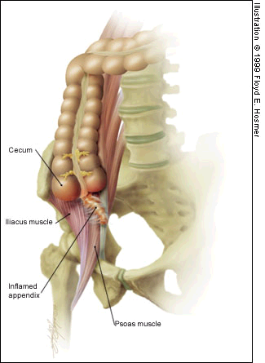
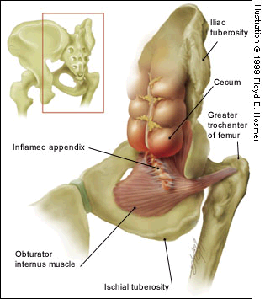
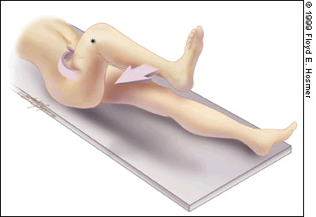
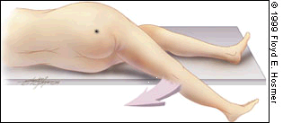
Psoas
sign
Obturator
sign

Slide 23
Laboratory studies
WBC count and differential count
Leukocytosis with a left shift
C-reactive proteins
Urinalysis
Irritation of the bladder or ureters by an inflamed appendix may result in a few WBCs in the urine.

Slide 24
Imaging:
Graded compression Ultra sound
Sensitivity = 85%, specificity = 94% in pediatric patients
Computed Tomography scan
In children, the CT scan has had a limited role.
CT scans are useful for patients in whom the ultrasound findings are equivocal.
Plain abdominal radiography
Barium enema
Radio-nucleotide study.
Notes:
Specific findings can support the diagnosis.
Non-compressible dilated appendix
Transverse diameter of 6 mm or more.
Lack of peristalsis
Peri appendiceal phlegmon or abscess formation.
An appendicoliths
Focal tenderness over the inflamed appendix

Slide 25
The MANTRELS score
M =Migration of pain to the RLQ 1
A = Anorexia 1
N = Nausea and vomiting 1
T = Tenderness in RLQ 2
R = Rebound pain 1
E = Elevated temperature 1
L = Leukocytosis 2
S = Shift of WBC to the left 1
Total 10

Slide 26
Management
Children with a classic history for appendicitis require prompt surgical intervention.
Kept NPO
Administer analgesics once decision is made
IV fluids and ensure adequate hydration.
Antibiotics Gm-ve and anaerobic organisms such as E. coli and Bacteroides.
Appendectomy is the definitive treatment for acute appendicitis.

Slide 27
Complications
Perforation
Sepsis
Shock
Dehiscence
Wound infection
Bowel obstruction
Abdominal/pelvic abscess
Death (rare)
The prognosis is generally excellent

Slide 28
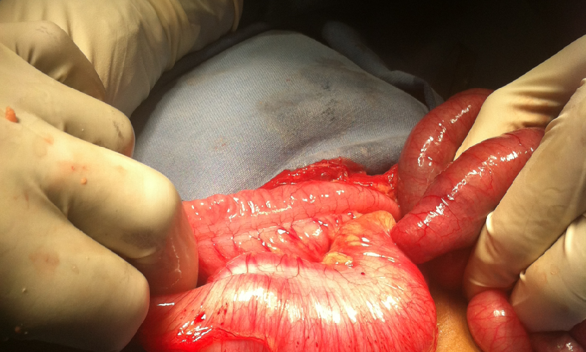
Intussusception

Slide 29
Introduction
Intussusception is the telescoping or prolapse of one portion of the bowel into an adjacent segment.
First described accurately be John Hunter in 1793.
Incidence: 1.5-4.3 per 1000 live births.
Peak incidence: 5-9th month of life.
60-70% are males, M:F= 3:1
In patients older than 4 years, the male-to-female ratio is 8:1.

Slide 30
Ethiopia
Study site: Addis Ababa, TAH, 1663-1970
Incidence: 6 cases per year
Mean age= 8 months, M:F 2:1
No seasonal variation
Average duration: 3.2 days
All are operated
Reduction in 76%
10/42 died; mortality=24%

Slide 31
Types: Ethiopia
Ileo-colic ~ 81%
Enteral ~ 2.4%
Colo-colic ~ 16.6%
Acute
Sub acute
Chronic and recurrent

Slide 32
Etiology
Primary idiopathic ~ 90%
Lymphoid hyperplasia
Defective peristalsis
Mal-fixation of the cecal mesentery
Secondary ~ 10% : common with advancing age
Meckle’s diverticula
Duplication cysts
Inflammatory lesions
Neoplastic lesions
Vascular/hematological lesions

Slide 33
Clinical findings
Previously health baby
Sudden repeated screams
Pallor and drawing of legs
Vomiting
Red currant jelly stool
Dehydration
Intestinal obstruction
Death in days
Painless intussusception
Fever and Tachycardia
Dehydration signs
Sausage in the RUQ or Epigastrium
Distended abdomen
Features of intestinal obstruction
Peritonitis
Bleeding PR
Mass PR

Slide 34
Management
Non operative reduction
Pneumatic or hydrostatic
Fluoroscopic or ultra sound guided
Success rate= 50-85%.
Contraindications
Signs of peritonitis or perforation
Demonstration of a lead point
Presence of shock
Chronic or neonatal intussusception

Slide 35
Management
Operative management: Indicated for those in whom Radiologic techniques are contraindicated or failed.
Right transverse muscle splitting incision
Gentle milking
Resection and end to end anastomosis if indicated
Appendectomy
Anti-recurrence precedures

Slide 36
Prognosis
Recurrent intussusception ~ 4%
Adhesive intestinal obstruction ~ 3-6%
Septic complications
Death ~ <1%
Mortality and morbidity are higher when there is delay in presentation or treatment, typically in older children and in small bowel intussusception !!

Slide 37
Peritonitis
The term peritonitis refers to a constellation
Abdominal pain
Tenderness on palpation
Abdominal wall muscle rigidity and
Systemic signs of inflammation.
May be
Primary ► Spontaneous
Secondary ► Related to a pathologic process in an organ
Tertiary ► Persistent or recurrent infection after adequate initial therapy.

Slide 38
Paths of bacterial invasion
Direct infection
Via a GI perforation
Via an abdominal wall breach
Post operative: Drains, foreign materials
Local infection
From an inflamed organ
Migration through a gut wall
Via the fallopian tubes
Blood-stream

Slide 39
Microbiology
Gram-negative
E coli
Enterobacter species
Klebsiella species
Proteus species
Gram-positive
Streptococcus species
Enterococcus species
Anaerobic
Bacteroides fragilis
Oather Bacteroides species
Clostridium species
Anaerobic Streptococcus species

Slide 40
Natural history
Localized peritonitis
Generalized peritonitis
Initial phase
Intermediate phase
Terminal phase

Slide 41
Clinical features: History
The diagnosis of peritonitis is clinical!!!
Abdominal pain
Dull and poorly localized ➔ Steady, more severe, ➔ More severe ➔ Generalized
Fever/ hypothermia
Anorexia, nausea and Vomiting
Diarrhea/Constipation
Symptoms referable to specific organs

Slide 42
Clinical features: Physical
Physical exam
Unwell and in acute distress
Fascis hippocraticus
Tachycardia, hypotension or overt septic shock.
Abdominal wall rigidity**
Tenderness and rebound tenderness**
Patients avoid all motion and keep their hips flexed
Hypoactive/absent bowel sounds.
Rectal and vaginal findings

Slide 43
Lab studies
CBC with differential
Leukocytosis/leucopenia with left shift
Serum electrolyte panel
BUN and creatinine
Coagulation profile
Liver function tests
Serum amylase and lipase levels
Urinalysis
Aerobic and anaerobic blood cultures
Peritoneal fluid analysis
Intra operative fluid analysis

Slide 44
Imaging studies: Auxiliary
Plain abdominal radiograph
CXR
Ultra sound
CT scan
MRI
Nuclear medicine imaging
Contrast scans

Slide 45
Treatment
The general principles of treatment are
(1) To control the infectious source
(2) To purge bacteria and toxins
(3) To maintain organ system function
(4) To control the inflammatory process.
Medical support includes
(1) Systemic antibiotic therapy
(2) Intensive care and organ function support
(3) Nutrition and metabolic support
(4) Inflammatory response modulation therapy.

Slide 46
Preoperative preparation
Fluid resuscitation + blood transfusion
Administration of antibiotics
Oxygen
Nasogastric intubation
Urinary catheterization
Monitoring of vital signs and homodynamic data.
Analgesia
Early surgery

Slide 47
Antibiotic therapy
Begin empiric therapy , mainly active against gram-negative organisms and anaerobes.
In uncomplicated peritonitis with early adequate source control, a course of 5-7 days is adequate in most cases.
Several studies suggest that antibiotic therapy is not as effective in later stages of the infection.

Slide 48
Surgery
Surgery remains an important therapeutic modality for all cases of peritoneal infection.
Any operation should address the first 2 principles of the treatment of intra-peritoneal infections:
Early and definitive source control
Purging of bacteria and toxins from the cavity.
Nonoperative interventional therapies include
percutaneous drainage of abscesses
percutaneous and endoscopic stent placements.

Slide 49
Complications of peritonitis
Residual abscess
Bacterial septicemia
Bronchopneumonia
Electrolyte imbalance
Renal; failure
Bone marrow suppression
Multi organ failure
Post operative adhesion
Paralytic ileus

Slide 50
Prognosis
Average mortality=10%
Appendicitis, PUD: 10%
Post operative: 50%
Fecal: 75%
Mortality depends on:
the degree and duration of peritoneal contamination
the age of the patient
The general health of the patient
The nature of the underlying cause

Slide 51
References
Intussusception in Ethiopia: Asrat Woldeyes and Tor Von Schreeb, EMJ 1973.
Pediatric intussusception: Br. J. Surg, 1992, Vol 79,September 867-876
Peritonitis and Abdominal Sepsis Last : September 29, 2004, Thomas Geniut.
Intussusception, Child Last: June 10, 2005, Beverly P. Wood
Appendicitis, Acute May 26, 2005, Sandy Craig.
The diagnosis of Acute Abdomen- Text book , Sir Zachary Cope.
Pediatrics, Appendicitis: June 9, 2004, Jeffrey Tucker.
Surgery international: Acute appendicitis in the child.
Sabiston Text book of surgery
Maingot’s, Text book of abdominal surgery

Slide 52
Thank you very much!!

